Slide 1


Computational Intelligence (TC2027)

Slide 2
Unit 5 – System Security (VI)
Domain Name Server (DNS)

Slide 3

Domain Name System (DNS)

Slide 4
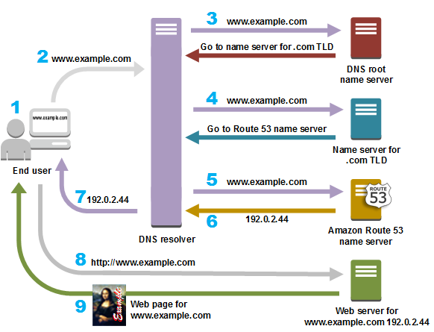
Domain Name System (DNS)
Translate host names to IP addresses
E.g., www.google.com ➔ 74.125.91.103
Hostnames are human-friendly
IP addresses keep changing
And back
From IP addresses to DNS name

Slide 5
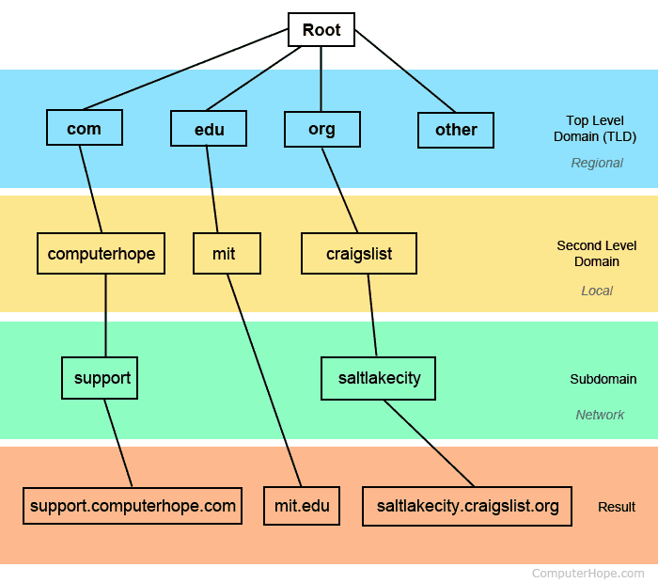
Domain Name System (DNS)
DNS is a Distributed Database:
Information is stored in a distributed way
Highly dynamic
Decentralized authority
DNS is a hierarchical name space.

Slide 6
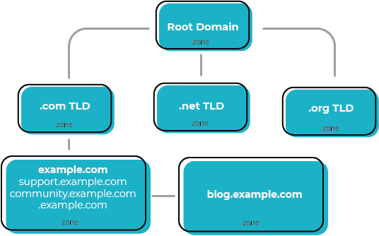
Domain Name Space
Domain: A node in the DNS tree
DNS Zones
A zone is a group of nodes in the tree, authoritatively served by an authoritative nameserver.
Each zone may be sub-divided, the parent zone
Authority servers
Answer queries about their zones
Provide mapping for leaf nodes or downward delegation
Hierarchical service
Root name servers for top-level domains
Authoritative name servers for subdomains
top-level domain (TLD)

Slide 7
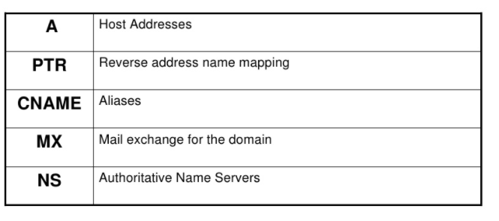
DNS Type of Recorder (RR)

Slide 8
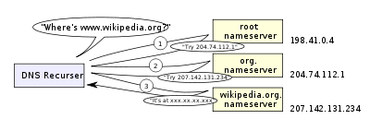
DNS Resolver: Recursive Resolver
Recursive resolver
Normally thought of as a “DNS server”
Accept queries from users, understand the zone hierarchy, interact with the authority servers
Cache answers

Slide 9
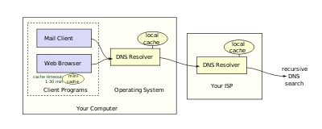
DNS Resolver: Stub Resolver
Stub resolver
Not interact with the zone hierarchy
Pose basic queries to recursive servers
May cache answers
PC, client applications
From wikipedia

Slide 10
DNS Lookup
Stub resolver asks “www.google.com”
Assume no previous results cached at the recursive resolver
Query the root servers (authority servers for “.” zone)
Answer: downward delegation
com NS a.gtld-servers.net NS: Name Server
a.gtld-servers.net A 74.292.124.59 A: Address
Query the “.com” zone authority servers
Answer: downward delegation
google.com NS ns1.google.com
ns1.google.com A 122.45.212.57
From wikipedia

Slide 11
DNS Lookup
Query the “google.com” zone authority servers
Answer: www.google.com A 24.122.49.76
The answer is returned to the stub resolver
The results are cached by the recursive resolver
From wikipedia

Slide 12
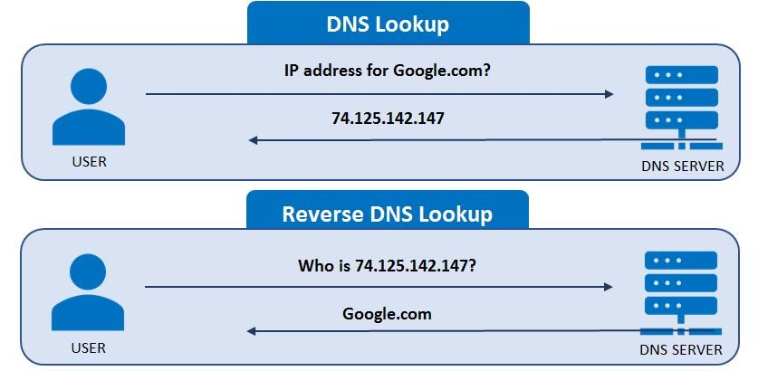
DNS Reverse Lookup
From wikipedia

Slide 13

DNS Vulnerabilities
Users/hosts typically trust the host-address mapping provided by DNS
DNS resolvers trust responses received after sending out queries
Responses can include DNS information unrelated to the query
Obvious problems
No authentication for DNS responses

Slide 14
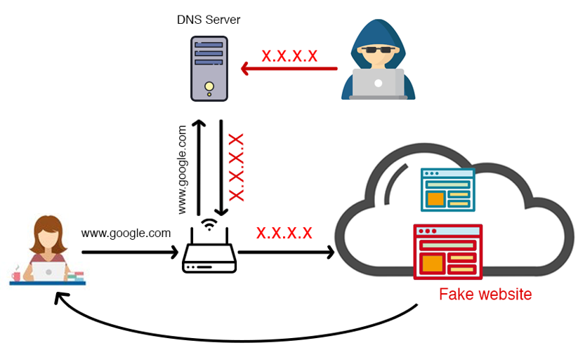
Pharming
Exploit DNS poisoning attack
Change IP addresses to redirect URLs to fraudulent sites
Potentially more dangerous than phishing attacks
No email solicitation is required

Slide 15
Defense Using The Bailiwicks Rules
The bailiwick system prevents foo.com from declaring anything about com, or some other new TLD, or www.google.com
Using the bailiwicks rules
The root servers can return any record
The com servers can return any record for com
The google.com servers can return any record for google.com

Slide 16
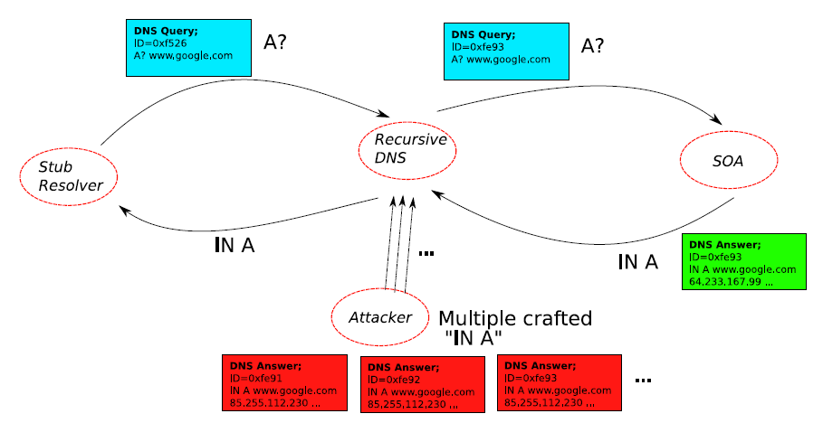
DNS cache poisoning: Racing to Respond First

Slide 17
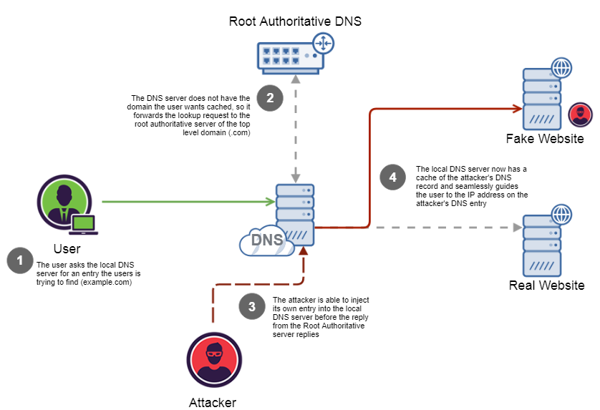
DNS Cache Poisoning
Attacker wants his IP address returned for a DNS query
When the resolver asks ns1.google.com for www.google.com, the attacker could reply first, with his own IP.

Slide 18
DNS Cache Poisoning
What is supposed to prevent this? Transaction ID
16-bit random number
The real server knows the number, because it was contained in the query
The attacker has to guess

Slide 19
Guess the ID
Early versions of DNS servers deterministically incremented the ID field
Vulnerabilities were discovered in the random ID generation
Weak random number generator
The attacker is able to predict the ID if knowing several IDs in previous transactions
Birthday attack
Force the resolver to send many identical queries, with different IDs, at the same time
Increase the probability of making a correct guess

Slide 20
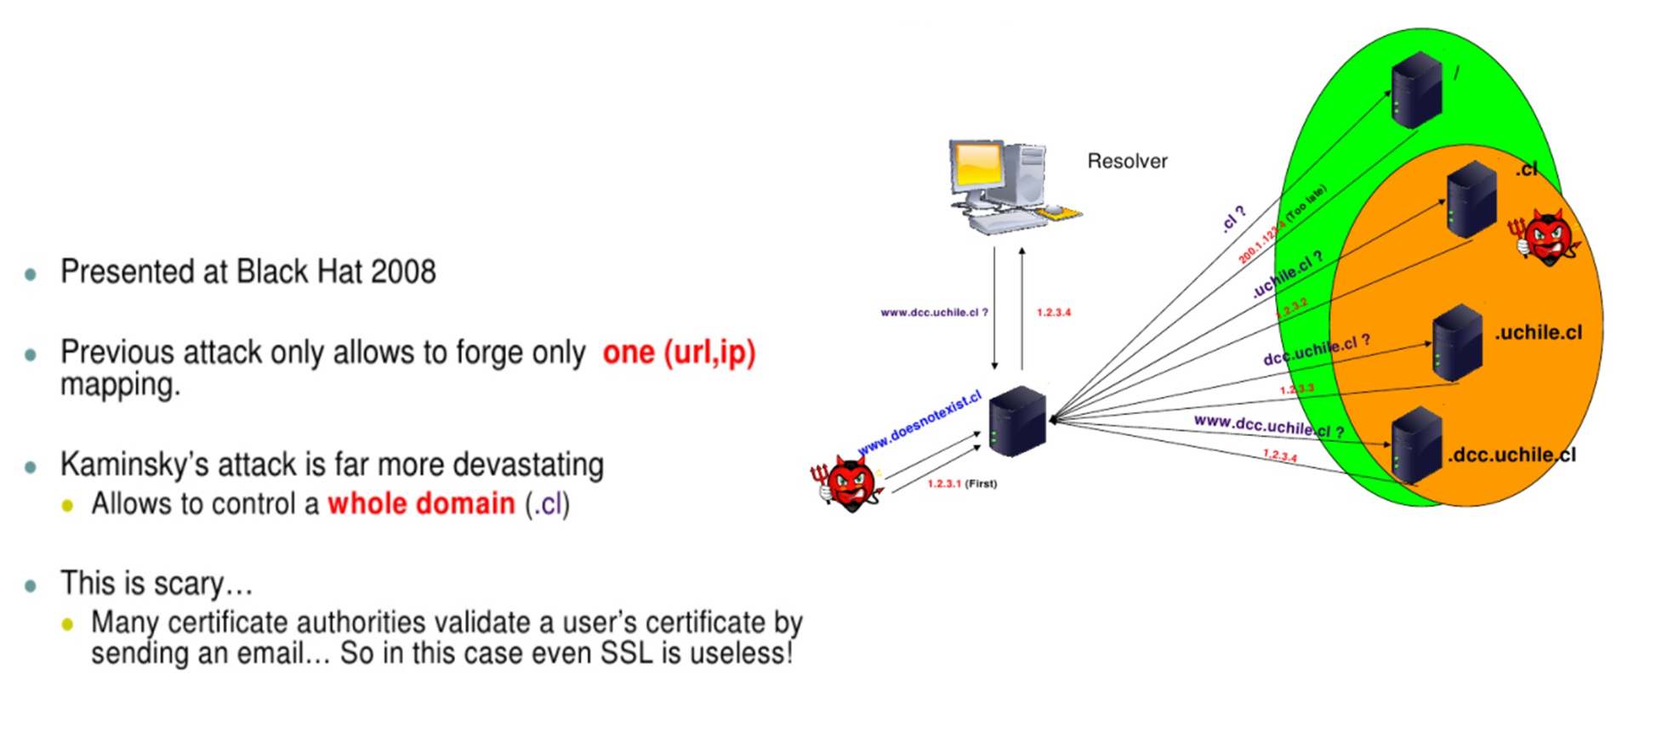
Kaminsky Attack

Slide 21
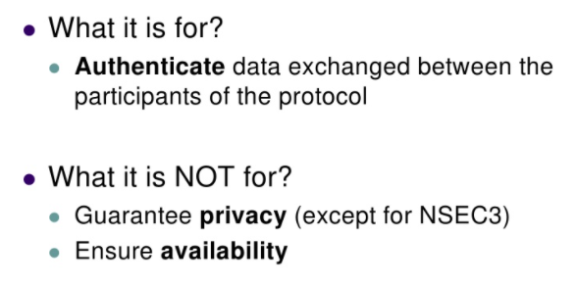
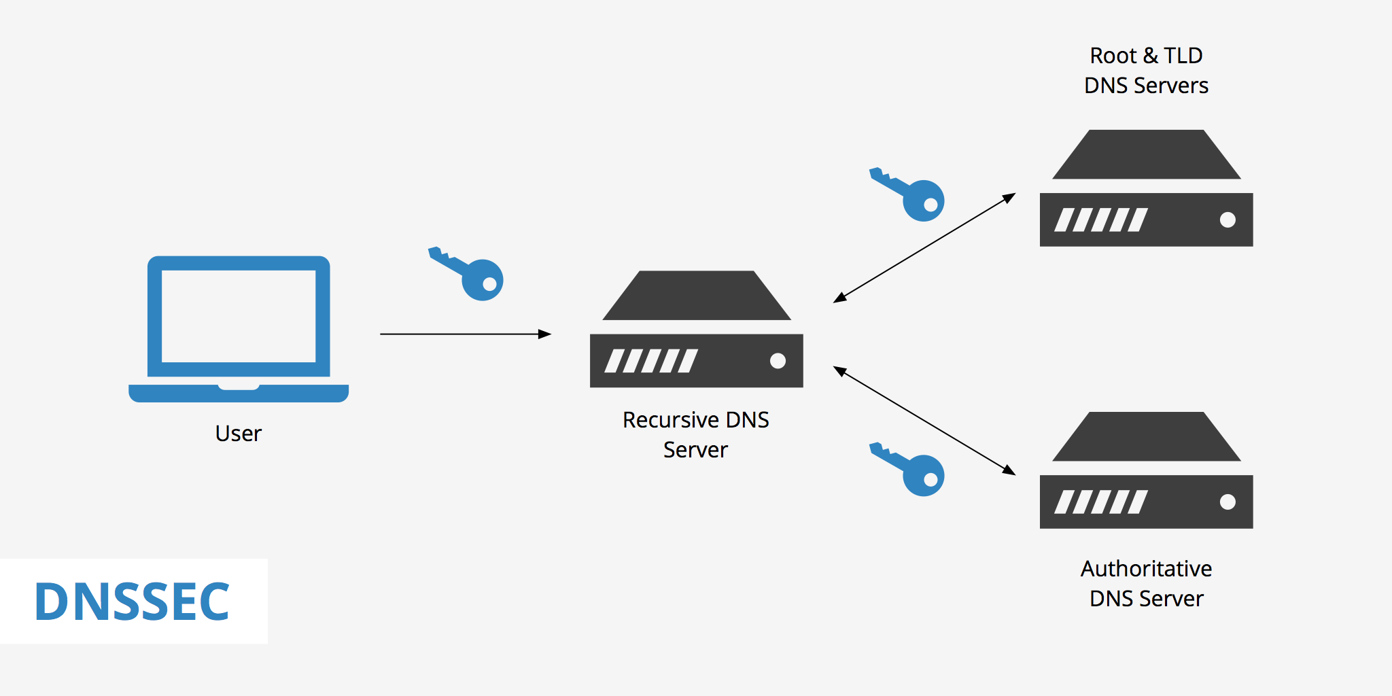
DNSSEC
Notes:
An NSEC3-record links to the next record name in the zone (in hashed name sorting order) and lists the record types that exist for the name covered by the hash value in the first label of the NSEC3 -record's own name.
These records can be used by resolvers to verify the non-existence of a record name and type as part of DNSSEC validation.

Slide 22
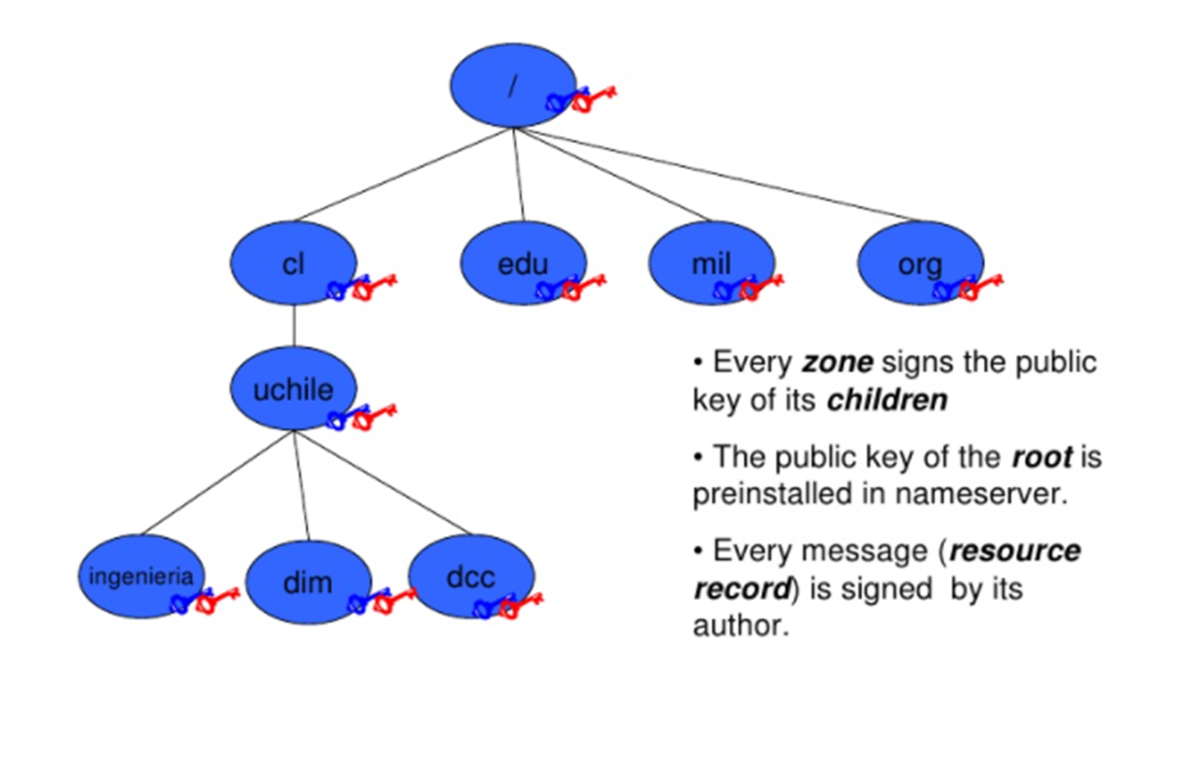
DNSSEC
Notes:
An NSEC3-record links to the next record name in the zone (in hashed name sorting order) and lists the record types that exist for the name covered by the hash value in the first label of the NSEC3 -record's own name.
These records can be used by resolvers to verify the non-existence of a record name and type as part of DNSSEC validation.

Slide 23
DNSSEC
Since DNSSEC, by design, should not change the DNS protocol, new types of DNS records, Resource Records, have been added to handle cryptography.
RRSIG
DNSKEY
ZSK
KSK

Slide 24
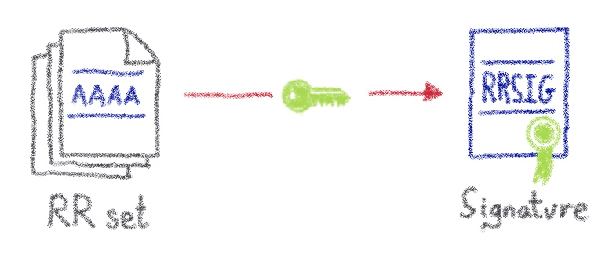
RRSIG
RRSIG contains the cryptographic signature of a record set. With DNSSEC, each record set is followed by a RRSIG containing, among others, the signature in base64 of the record set.

Slide 25
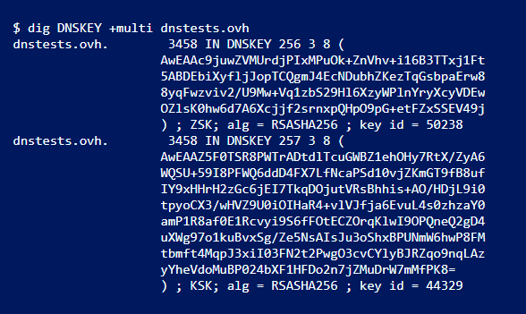
DNSKEY
In order to validate, a RRSIG resolver needs to know the public key used to sign the record set.
This is stored in a record named DNSKEY.

Slide 26
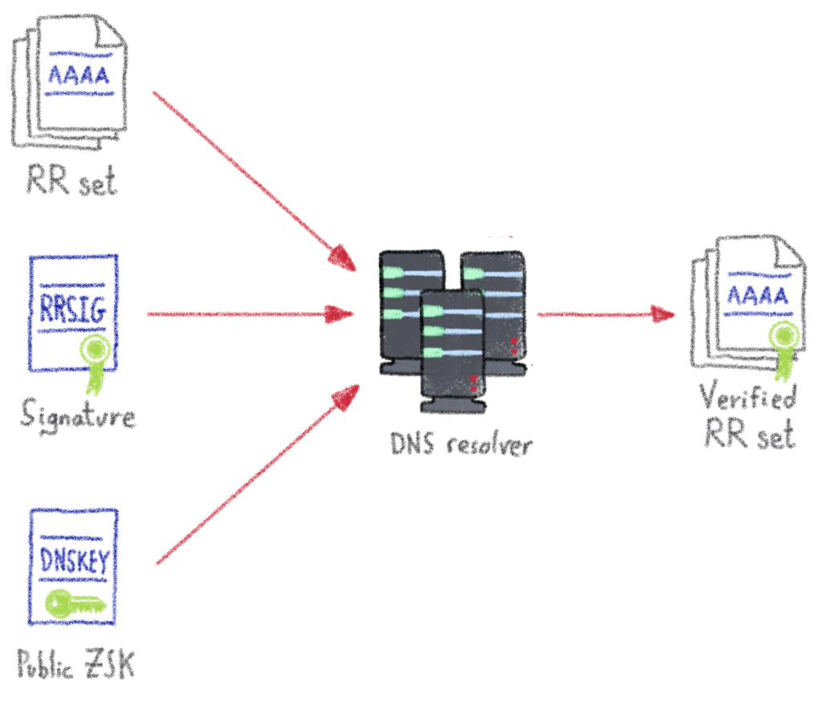
ZSK
Each zone signed with DNSSEC has a key named ZSK used to sign the whole record set.

Slide 27
KSK
In the same way that the ZSK is used to sign the record set, the DNSSEC use another key – the KSK (Key Signing Key) – which is used to sign the ZSK DNSKEY.

Slide 28
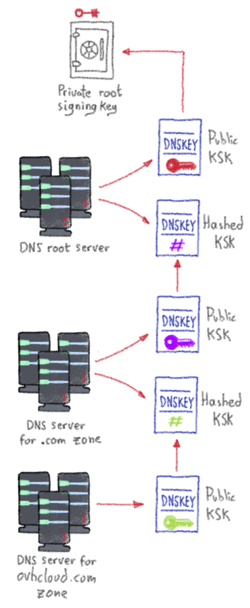
The Chain of Trust
We are now able to fully validate a DNS answer, up to the root DNS servers:

Slide 29
Denial of Existence
Imagine we want to resolve “doesnotexist.dnstests.ovh.”. The resolver will send us back to: domain doesn’t exist. So, how can we validate this denial of existence?
DNSSEC solves this problem by adding two new types of record: NSEC and NSEC3.

Slide 30
Denial of Existence
NSEC: works by returning the “next secure” record.
It tells us that the next subdomain is subdomain.dnstests.ovh., so we can get the next subdomain by adding a letter to the subdomain.

Slide 31
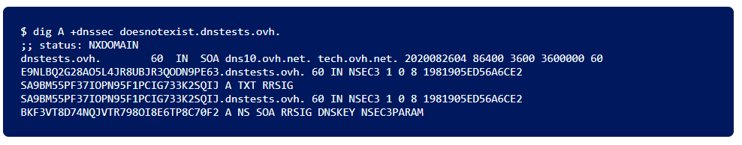
Denial of Existence
NSEC3: was added to prevent an attacker from walking the zone. It works the same way as the NSEC, but it constructs a chain of hashed and not plain text resource records.

Slide 32
Unit 5 – System Security (VI)
Domain Name Server (DNS)

Slide 33
Computational Intelligence (TC2027)

